Slide 1
Henry VIII Tudor
Marta Bednarska, klasa 1F

Slide 2
Henry VIII
Henry VIII, son of Henry VII , was born on the 28th of June, in 1491 in Greenwich. He was the king of England from April 21, 1509 to the end of life, Lord of Ireland in the years 1494-1542, then king of Ireland from 1542 to 1547 . He was crowned king after the death of his brother Arthur. He was a very greedy man. He was very musically talented and good at sports. He died in 1547.

Slide 3
Six wifes of Henry VIII

Slide 4
Catherine of Aragon
Catherine of Aragon (1485-1536)
She was the first wife of Henry VIII. She bore him six children, but just Mary survived. Catherine didn’t feel good in England and she missed Spain. Henry VIII thought their marriage is unholy. In 1533 the king got divorce.
To the end of the life Catherine was alone.

Slide 5
Anne and Mary Boleyn
Anne Boleyn, Tom Boleyn and Elisabeth Howard’s daughter, was born in 1501/1507. Anne was crowned queen on 1 June 1533. The seventh of September 1533, the Princess Elizabeth came to the world. Anne Boleyn was beheaded in the Tower of London on May 19 in 1536
Anne’s sister, Mary Boleyn, was born in 1499/1500.
She was the royal mistress in the years 1521-1526, and probably two of her children, Catherine born in 1524, and Henry, born in 1526, were the children of Henry VIII.

Slide 6
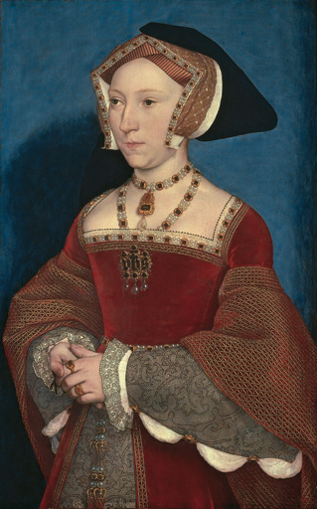
Jane Saymour
Jane Saymour(1509-23 October 1537), the third wife of HenryVIII. The king married her May 30 in 1536, just 11 days after the death of Anne Boleyn. Only Jane gave him the royal heir, Edward VI. She was warm and mild, what was unusual among her predecessors . Unfortunately she died some days after the childbirth. Henry VIII was distraught.

Slide 7
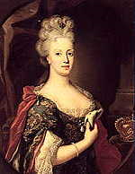
Anne von Kleve
Due to the prevailing situation in Europe, Thomas Cromwell - the principal advisor to the king - offered him a new wife Anne von Kleve (1515-1557). She did not like the king, so he pushed her from the throne and began looking for a new wife.

Slide 8
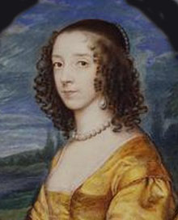
Catherine Howard
Catherine Howard(1521/1525-13 February 1542)
The marriage of a young girl with the creepy (he weighed nearly 140kg and his ulcer on the leg had smelling unpleasant), aging man, for her was hard to bear – so she found a pleasant change in the arms of another man (the favorite courtier of Henry, Thomas Culpeper) for what was later beheaded.

Slide 9
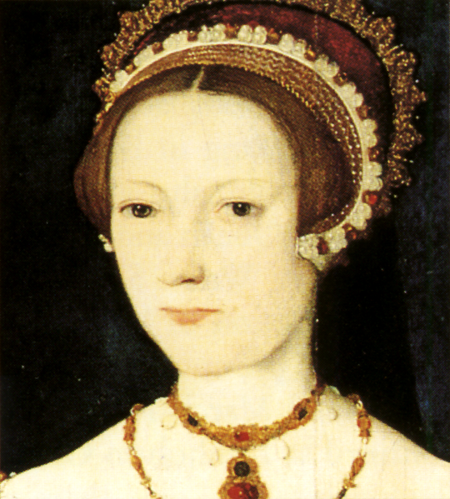
Catherine Parr
Catherine Parr(1512– 5 September 1548)
Wedding of Catherine and Henry was held on 12 of July, 1543 in Hampton Court Palace. She was the only compan for the aging king. He didn't expect too much from her. After the death of Henry VIII in 1547 Catherine could marry her old love, Thomas Seymour. Catherine's daughter, Mary Seymour, was put under the care of her cousin, who took her as another burden. Mary died at the age of about 2.

Slide 10
Henry VIII’s children

Slide 11
Edward was born in 1537. He was the last child of the king and his third wife Jane Saymour. He never reigned by himself- he was too young. He died at the age of 16.
Mary Tudor was the daughter of Henry VIII and his first wife Catherine of Aragon. She was born in 1516. Mary was older sister of king Edward VI and queen Elisabeth I, but all of them had different mothers. She died in 1558.
Elisabeth I(1533-1603) was the second child of Henry VIII and Anne Boleyn. She was the last Tudor. Elisabeth never got married, that is why she was called the ,,Virgin Queen”.

Slide 12
Henry VIII was Catholic. When the Pope didn’t let the king divorce, he founded Evangelic Church. When Edward was king, the main religion was Protestantism. After his death, Mary tried to restore her mother’s religion- Catholicism in a very bloody way. Since the reign of her sister- Elisabeth I , England has been a Protestant country.

Slide 13
The END

